Slide 1
Web Applications and Servlets

Slide 2
Web servers
Client and server can either refer to the physical machines or the software
Request
Client
Response
Server

Slide 3





Web clients
A web client lets the user request something on the server, and shows the user the result of the request
Usually a web client is a browser which can display images and HTML

Slide 4
Review: HTML and HTTP
Hypertext Transfer Protocol (HTTP)
Client and server communicate using HTTP
Client sends a request, server replies with a response
Hypertext Markup Language (HTML)
Web pages are generally composed of HTML with other resources (images etc) embedded
They might be static .html files
Or dynamic scripts that generate HTML, e.g. PHP, ASP, JSP

Slide 5
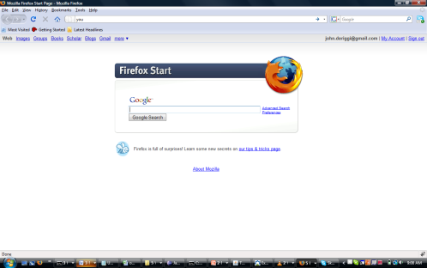
HTTP
http request
A network protocol like TCP/IP with web features
Follows a request/response configuration
http response
Request
Response
Method
Page (resource)
Parameters
Status Code(success or not)
Content-type (text,picture)
Content(html, image, etc..)

Slide 6

HTML is Part of HTTP Response
Browser renders the html content of the response
HTTP Header
Content-type
Status codes….
Content
<html>
<head>…
http request

Slide 7
HTTP Request
Reqeust contains the request method:
Most common request methods are:
Get – a simple request for requesting a resource like an html page, an image, etc
Post – can submit some data and a request

Slide 8

GET
Browser makes a GET request, asking the server for a page
http get request

Slide 9
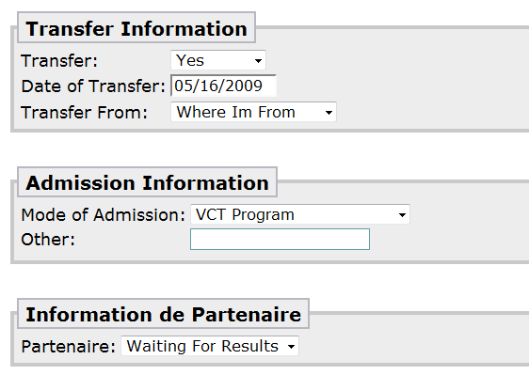
Post
Browser sends the form data to the server
http post

Slide 10
GET and POST Summary
GET – a simple request to the server for a resource
POST - more powerful than get because you can request a resource and submit form data too

Slide 11

Sending Data with GET
Parameters sent in a GET request is limited by an amount that is dependant on the server
Data is appended to the URL

Slide 12
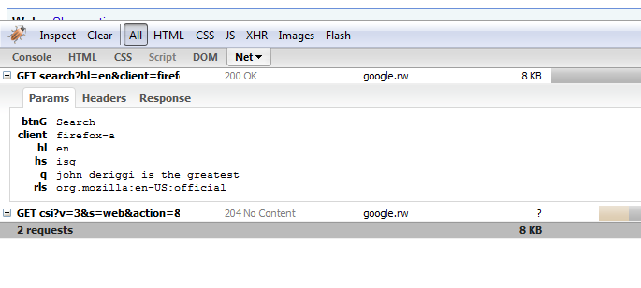
GET Request in FireBug
Parameters

Slide 13
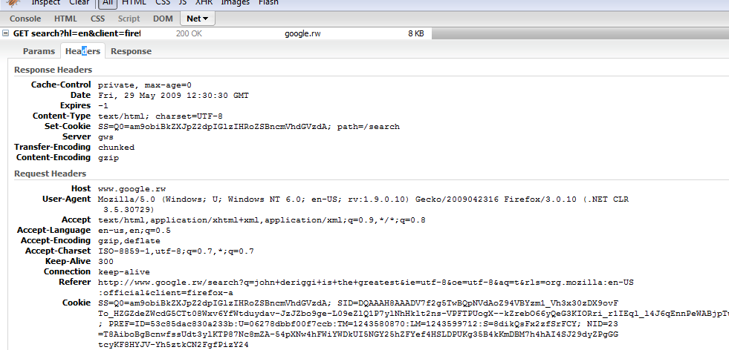
GET Request in FireBug
Headers!

Slide 14
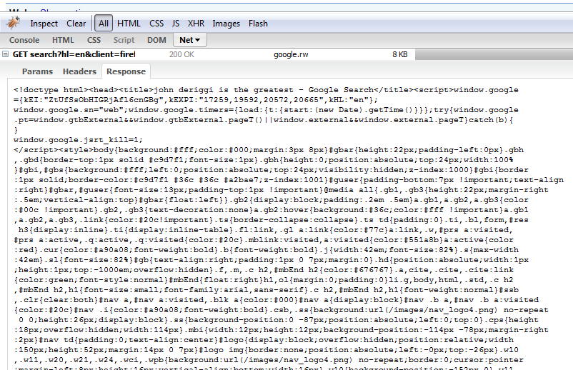
GET Request in FireBug – Response!

Slide 15
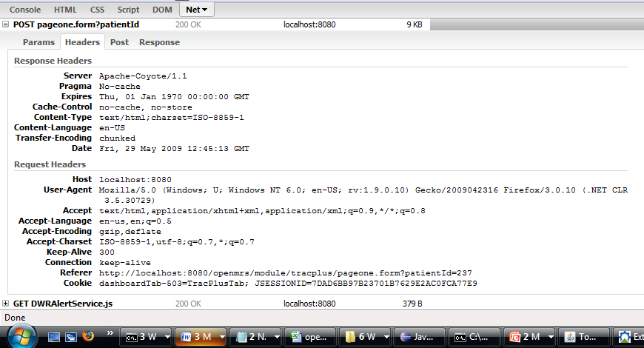
POST Request in FireBug

Slide 16
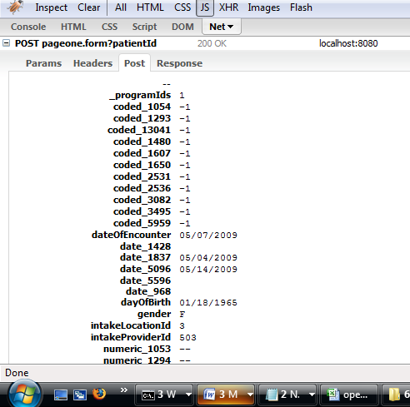
POST Request in FireBug

Slide 17
POST Request
The parameters are in the body of the message so they are not limited in size!

Slide 18
HTTP Response
HTTP Response
HTTP/1.1 200 OK
<html><title></title></head>
<body>…
Body Contains HTML

Slide 19
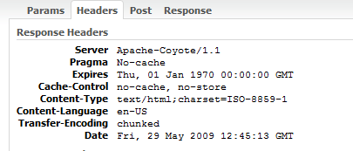
HTTP Response
Response Headers

Slide 20
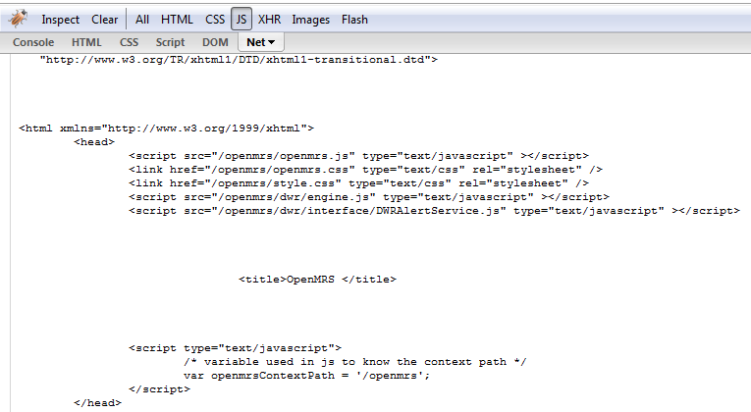
HTTP Response Payload

Slide 21
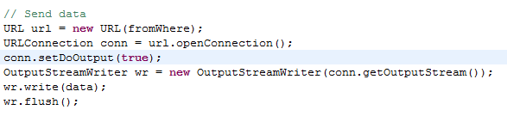

Slide 22
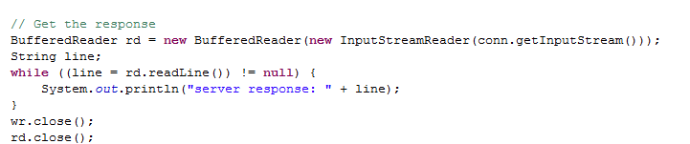

Slide 23
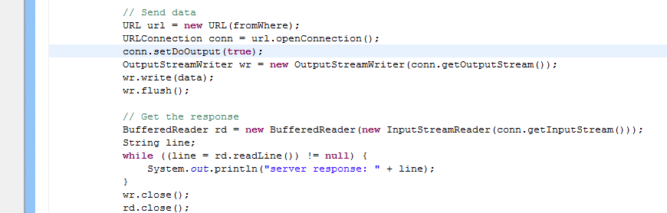
And By the Way, You Can Try This With Java

Slide 24
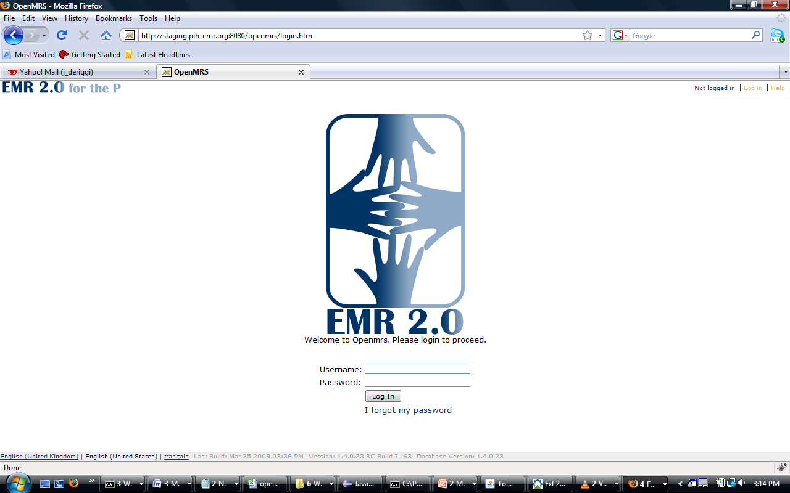
URL

Slide 25


URL – Uniform Resource Locator

Slide 26
URL
Protocol
Port
Resource
Server
Path
Optional Query String

Slide 27
Protocol
Tells the server which communications protocol will be used

Slide 28
URL
Protocol
Server
Port
Resource
Path
Optional Query String

Slide 29
Server
The unique name of the server. The name maps to a unique IP address. You can just specify the IP address if you want.

Slide 30
URL
Protocol
Server
Port
Resource
Path
Optional Query String

Slide 31
Port
A server may support many ports and you can specify a server application with the port number.
If not specified then it defaults to port 80

Slide 32
URL
Protocol
Server
Port
Path
Resource
Optional Query String

Slide 33
Path
The path to the location on the server. The earliest web servers were Unix machines so we use Unix syntax for file locations

Slide 34
URL
Protocol
Server
Port
Path
Optional Query String

Slide 35
URL
Protocol
Server
Port
Path
Resource
Optional Query String

Slide 36
Resource
The name of the requested content. HTML, PDF, a video, etc

Slide 37
URL
Protocol
Server
Port
Path
Resource
Optional Query String

Slide 38

GET Request Query String
In a GET Request there may be parameters on the end of the URL

Slide 39
TCP Port
A 16-bit number that identifies a program on the server
Examples:
HTTP Web servers run on port 80
FTP servers run on port 20
HTTPS runs on port 443
MySQL defaults to port 3043
TCP Port numbers range from 0 – 65536
Generally speaking, ports from 0 – 1023 are reserved for administrative applications

Slide 40
TCP Port
Ports allow the server to determine which applications should be connected to the client
One server application per port! BindException ← look it up!
Web Server
Port 80
MySQL
Port 3043

Slide 41
Apache Web Server?

Slide 42
Web Servers and Static Web Pages
HTML Content is delivered to the client exactly like it is on the server
Web server application
<html>…
web server machine
client

Slide 43
Web Servers and Dynamic Pages
Can serve pages. Does not do any computation
Web server application
Web server can delegate to a helper application
Another application

Slide 44
Web Server Alone Cannot…
Serve Dynamic Content
A web server needs to communicate with another application on the server to assembel
Saving Data
When a web server receives data from a form or an uploaded file for example, it must hand it off to another application to save it to a file

Slide 45
CGI – Common Gateway Interface
Can be written in many languages.
Common ones are:
Perl
Python
C
PHP

Slide 46
Web Server and Helper Application
Web Server Machine
Request with params
Helper Application
Web Server Application
params
<html>….
HTTP/1.1 200 OK
<html><title></title></head>
<body>…

Slide 47
Web App Architecture
Servlets have not a main() method
Servlets are controlled by a Java Application called a Servlet Container
Web Server Machine
HTTP GET Request
container
servlet
Web server app
HTTP GET Request
HTTP GET Request

Slide 48
Web App Architecture
Servlets have not a main() method
Servlets are controlled by a Java Application called a Servlet Container
Web Server Machine
HTTP/1.1 200 OK
<html><title></title></head>
<body>…
container
servlet
Web server app
<html>….
<html>….

Slide 49
The Container Does Many Things
Communications Support - It handles the communication between the servlet container and the web server
Lifecycle Management – Handles the loading and instantiating of servlets, invokes(calls) the servlet methods and making the objects available for garbage collection.
Multihtreading Support – New threads are created for each servlet request
Declarative Security – Configurable Security Management without modifying Java source files
JSP Support – Converts a JSP into Java

Slide 50
Container Request
Container create a request and response object
HTTP Request
Web Server Machine
container
servlet
Response
Request

Slide 51
Container Request
Container create a request and response object
HTTP Request
Web Server Machine
container
servlet
Response
Request

Slide 52
Container Request
Container finds the servlet corresponding the the url, spawns a thread, passes the objects to the thread
HTTP Request
Web Server Machine
servlet
container
Request
Response
thread

Slide 53
Container Request
The Container calls the service method which then calls either doGet() or doPost()
Web Server Machine
servlet
container
thread
Response
service()
<html>….
doGet()

Slide 54
Container Request
The container converts the response into an http response and sends off to the client. The request and response objects are deleted
HTTP/1.1 200 OK
<html><title></title></head>
<body>…
Web Server Machine
servlet
container
thread
Response

Slide 55
Servlets
A basic servlet exercise
The Deployment Descriptor
Deploying the web application

Slide 56
Exercise
Build our development environment
Write the servlet
Create the deployment descriptor
Deploy the app

Slide 57
Servlet Exercise
This exercise is describe between slides 60-64. You may do it at your own pace

Slide 58
Create This Development Environment
Project
src
classes
web
web.xml
FirstServlet.java
servletfun

Slide 59
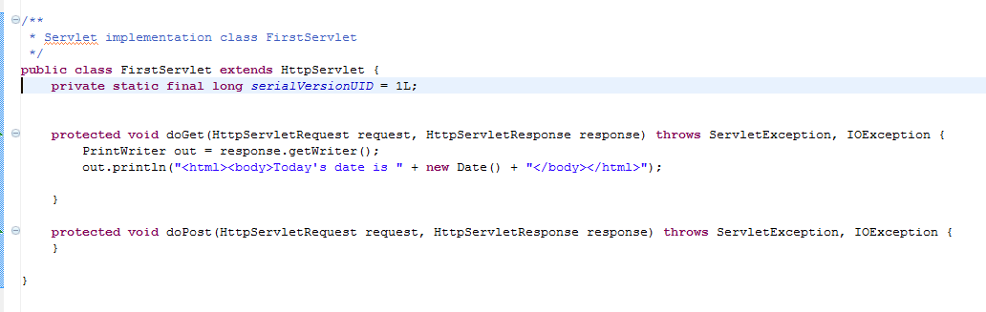
servletfun.FirstServlet - The Servlet

Slide 60
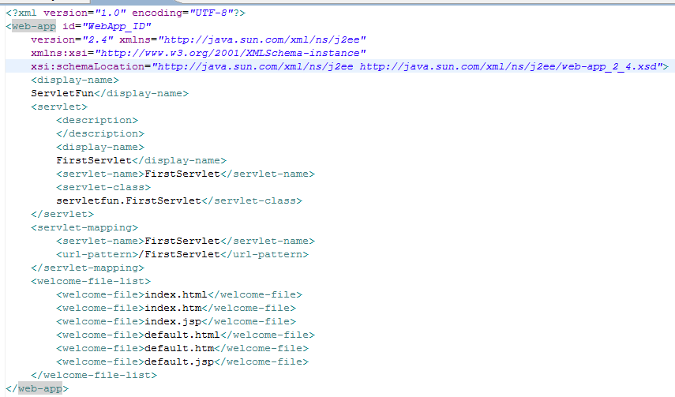
web.xml - The Deployment Descriptor

Slide 61
Build This Deployment Structure
<Tomcat home>
webapps
firstwebapp
WEB-INF
web.xml
classes
FirstServlet.class
servletfun

Slide 62
Start Tomcat and View the Web App
<tomcat home>/bin/startup.sh
http//:localhost:8080/firstwebapp/FirstServlet
Shutdown tomcat:
<tomcat home>/bin/shutdown.sh

Slide 63
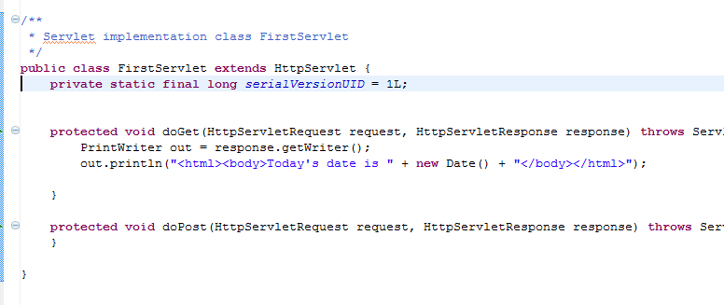
So What Did We Just Do?
The request and response references from the container
We will almost always override doGet() or doPost()

Slide 64
The Container Must Find the Servlet
The URL from the request is mapped to a specific servlet (does everyone know what it means to create a mapping)
Think HashMap

Slide 65
The Deployment Descriptor
An XML document to tell the container how to run your servlets and JSPs
You can do many things with the deployment descriptor
For now, let's look at the servlet mapping

Slide 66
The Deployment Descriptor
<servlet>
maps internal name to a fully qualified class name
<servlet-mapping>
maps the internal name to the public URL name

Slide 67
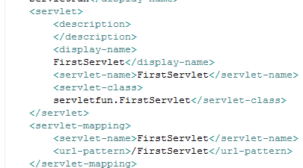
The Deployment Descriptor
Used only within the DD
Public name
Used only within the DD

Slide 68
Deployment Descriptor
2) the container uses the name…
1) When a request comes in for this URL…
3) and invokes the corresponding servlet

Slide 69
A Few Other Things You Can Do With the Deployment Descriptor
Can adjust security roles
Configure welcome pages
Configure error pages

Slide 70
Exercises
URLEncoder get or post request
Servlet to render html
Servlet to process form entry
A basic web app

Slide 71
A Bit About Devlelopment Environments
To stay organized, we create separate places for:
Source files (.java files)
Class files (.class files)
lib files (.jar files)
Configuration files(.xml, .properties)

Slide 72
Let's Build a Web Application
Examine the view design (what's displayed in the browser)
Create the development environment
Create the deployment environment
Perform behavior validation during design

Slide 73
Application Behavior
Read a parameter from the user's form
Render html with the parameter and the current date and time

Slide 74
Create Development Environment
Project
itemselector
etc
lib
Project Root
classes
web
src
firstwebapp
web
model
form.html
web.xml
DateMaker.java
FirstServlet.java

Slide 75
Create the Deployment Environment in Tomcat
tomcat
webapps
Itemselector
WEB-INF
form.html
classes
firstwebapp
web
model
web.xml

Slide 76
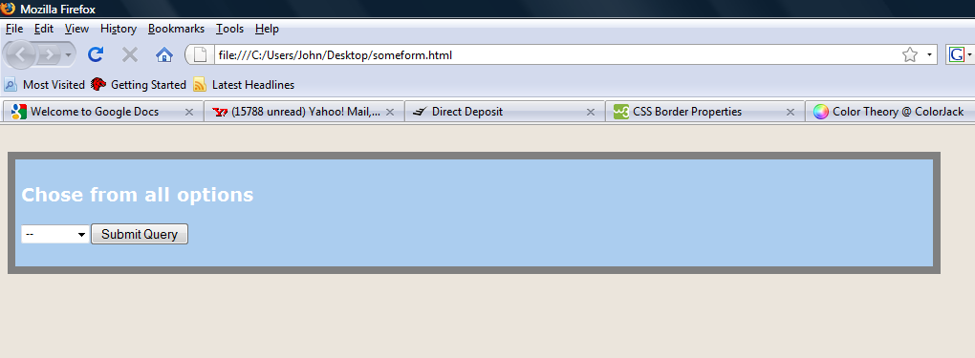
Views – form.html
A simple form where the user makes a selection

Slide 77
Create the HTML
Project
HTML Files
itemselector
etc
lib
src
classes
web
web.xml
firstwebapp
form.html
web
model
DateMaker.java
FirstServlet.java

Slide 78
Put the Deployment Descriptor In the etc Folder
Project
Deployment Descriptor
itemselector
etc
lib
Src
classes
web
web.xml
firstwebapp
form.html
web
model
DateMaker.java
FirstServlet.java

Slide 79
Create the Deployment Environment in Tomcat
tomcat
webapps
itemselector
WEB-INF
form.html
classes
firstwebapp
web
model
web.xml
Class files
Go here

Slide 80
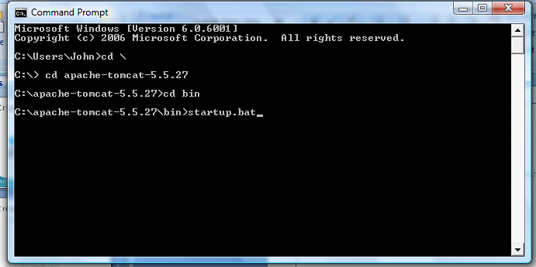
Start Tomcat
Find the html page in your browser
http://localhost:8080/firstwebapp/form.html

Slide 81
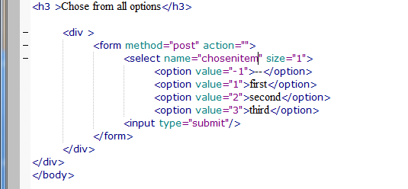
Create a Servlet
Reads a request parameter
request.getParameter("chosenitem");
Returns the selected value and the current date and time
The url for your servlet

Slide 82
Find the HTML Page in Your Browser
http://localhost:8080/firstwebapp/form.html
Submit the form and view the response from your servlet

